Slide 1
Tracking Indexes
vs. Financials
An ETF Correlation, Risk & Portfolio Strategy Analysis
Michael Zeghibe & Connor Correnti
CSC 485 — Data Science Capstone

Slide 2
Research Question
"How do correlations between popular ETFs — VOO, QQQ, ARKK, and MAGS — shift over time, and what does this mean for portfolio diversification?"
Why It Matters
Our Approach
Policy Relevance
Static correlation snapshots miss regime shifts — correlations spike during crises, eroding diversification when it's needed most.
Time-varying analysis across 1Y, 2Y, and 3Y rolling windows using monthly log returns, Bayesian updating, and Monte Carlo portfolio simulation.
Help retail investors understand when their 'diversified' ETF portfolio actually behaves like a single concentrated bet.

Slide 3
Data Overview & Provenance
ETF | Tracks | Style | Inception
VOO | S&P 500 | Broad Market / Passive | 2010
QQQ | Nasdaq-100 | Tech-Heavy / Passive | 1999
ARKK | Disruptive Innovation | Thematic / Active | 2014
MAGS | Magnificent 7 Stocks | Concentrated / Passive | 2023
Data Sources & Processing
Tools & Libraries
Price history scraped from online financial sources as Excel files. VIX loaded as a volatility reference. All prices aligned to common overlapping dates, converted to monthly end-of-month, and transformed to log returns.
R (primary): readxl, dplyr, tidyr, zoo, ggplot2, lubridate, gridExtra, reshape2
Python (portfolio sim): pandas, numpy, matplotlib
Visualization: Power BI (.pbix dashboard)
All code available on GitHub: michaelzeghibe/Tracking-Indexes-VS-Financials

Slide 4
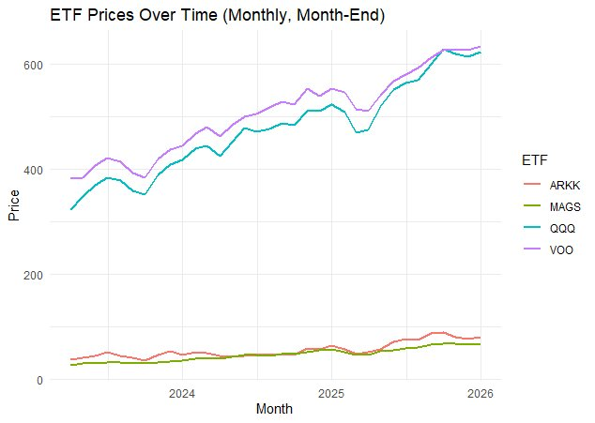
ETF Price Trends
Observations
VOO and QQQ trade at similar price levels ($400–$650), showing steady upward trends.
ARKK and MAGS trade at much lower absolute prices ($30–$80), reflecting their different fund structures.
The overlapping period (2023–2026) captures the post-pandemic recovery and AI-driven rally.
QQQ overtook VOO in price during the 2025 tech surge.

Slide 5
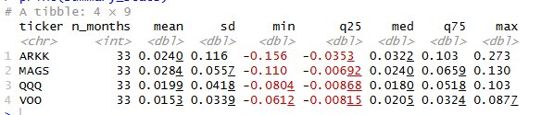
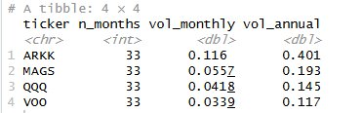

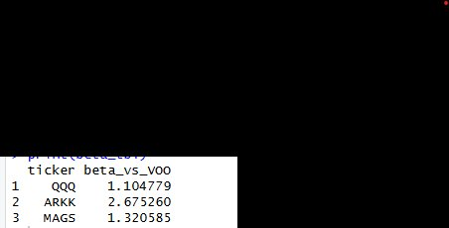
Exploratory Analysis: R Output
Summary Statistics
Annualized Volatility
Sharpe Ratios (rf = 4%)
Beta vs. VOO
40.1%
ARKK Vol
2.68
ARKK Beta
1.56
MAGS Sharpe
Highest risk
Extreme amplification
Best risk-adjusted

Slide 6
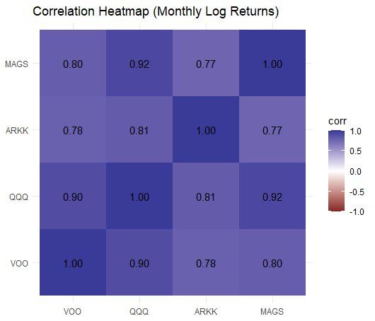
Static Correlation Analysis
Key Insights
QQQ–MAGS: 0.92
Move nearly in lockstep — holding both provides almost zero diversification.
VOO–QQQ: 0.90
High overlap due to mega-cap tech dominating both indexes.
ARKK–VOO: 0.78
Lowest correlation — ARKK offers the most decorrelation, but at extreme volatility cost.
ARKK–MAGS: 0.77
Active vs. concentrated passive strategies diverge more than expected.

Slide 7
Time-Varying Rolling Correlations
VOO Correlations
ARKK Correlations
VOO-QQQ stays tightly correlated (~0.9+). VOO-VIX is persistently negative — VIX hedges broad market risk effectively.
ARKK decorrelates sharply during the 2020 rally and 2022 crash. 1Y window shows ARKK-VOO dropping below 0.5.
QQQ Correlations
MAGS Correlations
QQQ maintains very high correlations with MAGS (0.90+) and VOO (0.85+). Limited benefit from holding both.
Shorter history limits 3Y windows. Strong co-movement with QQQ and VOO. MAGS-VIX is expectedly negative.
Methodology: 12-month (1Y), 24-month (2Y), 36-month (3Y) rolling windows on monthly log returns using zoo::rollapply in R.

Slide 8
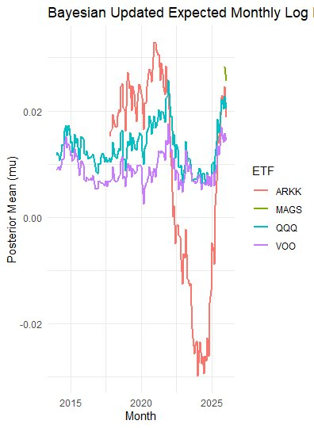
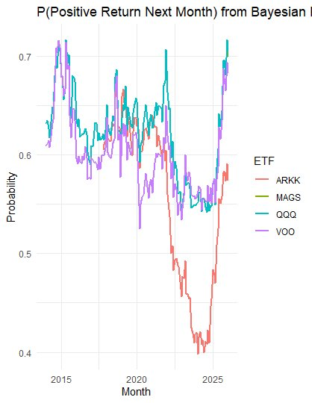
Bayesian Updating Framework
Expected Monthly Log Return (Posterior Mean)
P(Positive Return Next Month)
ARKK's posterior mean plummeted to –0.03 during the 2022 drawdown while VOO/QQQ remained positive. ARKK's probability of positive return fell below 42%, signaling a clear regime shift. The Bayesian model adapts allocation weights in real-time as new data arrives.

Slide 9
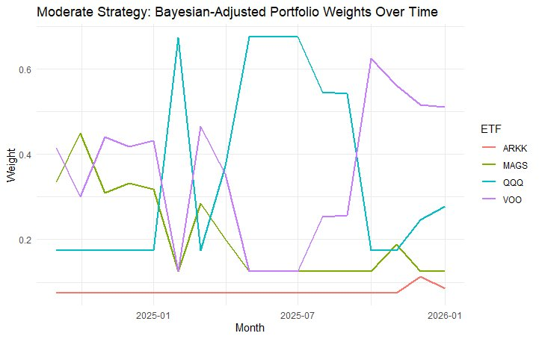

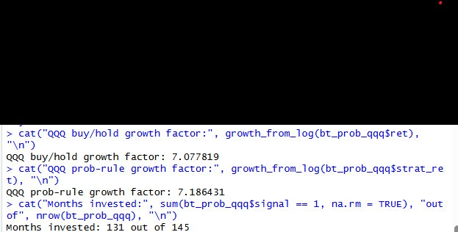
Bayesian Portfolio Adjustment
Exit & Trading Rules
Growth and exit rules compared across ETFs. VOO shows 5.38x growth; QQQ leads at 11.1x.
Growth Factor Output
QQQ prob-rule growth: 7.19x over 131/145 months invested — the Bayesian signal avoided 14 months of drawdowns.
Moderate Strategy: Bayesian-Adjusted Weights Over Time

Slide 10
Key Findings
01
Diversification Is Time-Dependent
Correlations between QQQ, VOO, and MAGS surge during stress. The 2020 and 2022 crises saw correlations spike above 0.95 — portfolios that looked diversified moved as one.
02
ARKK Is the Wild Card
ARKK offers decorrelation but at extreme cost — 40.1% annualized volatility, 2.68 beta vs. VOO. Useful only in small allocations for aggressive investors.
03
QQQ and MAGS Are Nearly Identical
With a 0.92 correlation, holding both is effectively doubling down on mega-cap tech. Investors should choose one, not both.
04
Bayesian Updating Adds Real Value
The Bayesian framework flagged ARKK's deterioration early. QQQ's prob-rule strategy achieved 7.19x growth while avoiding 14 months of drawdowns.

Slide 11
Limitations & Future Work
Limitations
Future Directions
Short MAGS history
Only launched 2023 — limits long-term backtesting and 3Y rolling windows.
No transaction costs modeled
Backtested returns assume frictionless rebalancing.
Static strategy weights
Allocation strategies use fixed starting weights.
Survivorship & selection bias
ETFs chosen ex-post based on current popularity.
33-month overlap
Common period limited to ~33 months due to MAGS inception.
Market regime identification
Apply Hidden Markov Models to detect bull/bear/crisis regimes.
Dynamic Bayesian rebalancing
Fully automate weight updates from posterior distributions.
Expand asset universe
Include bonds (BND), international (VXUS), commodities (GLD).
Real event mapping
Overlay Fed decisions and macro events on correlation charts.
Reproducible RMarkdown
Package all analysis into a single reproducible document.

Slide 12
Conclusion
Correlations between popular tech-oriented ETFs are not constant — they shift across market regimes, often converging during the exact moments investors need diversification the most. A time-varying, Bayesian approach to portfolio construction provides a more realistic and adaptive framework than static allocation models.
4 ETFs
3 Strategies
10K Portfolios
33 Months
Analyzed
Backtested
Simulated
Common Data
Michael Zeghibe & Connor Correnti | CSC 485 Data Science Capstone | Providence College
github.com/michaelzeghibe/Tracking-Indexes-VS-Financials

